Slide 1
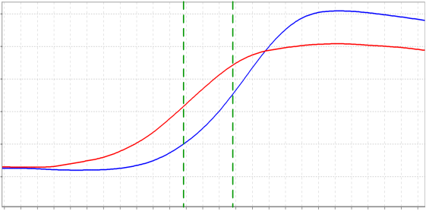
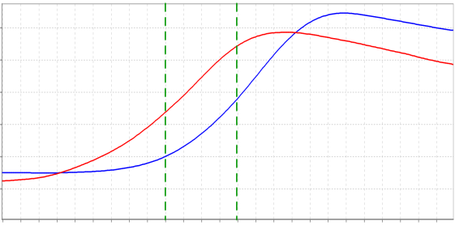
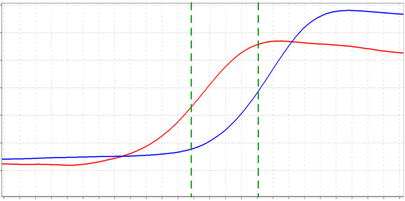
(a)
ZmDRIK1^{K217-P492}
(b)
ZmDRIK1^{K217-S514}
ΔTm
ΔTm
3.5°C
4.1°C
15000
15000
12500
12500
10000
ENMD-2076
10000
ENMD-2076
Fluorescence
Fluorescence
7500
DMSO
7500
DMSO
5000
5000
2500
2500
40
45
50
55
60
65
40
45
50
55
60
65
Temperature (°C)
Temperature (°C)
(c)
ZmDRIK1^{R187-P492}
ΔTm
4.3°C
15000
12500
10000
ENMD-2076
Fluorescence
7500
DMSO
5000
2500
40
45
50
55
60
65
Temperature (°C)
Figure S5. ZmDRIK1-KD bind the small molecule ENMD-2076. Thermal shift assay of ENMD-2076 binding to ZmDRIK1-KD (construct (a) ZmDRIK1^{K217-P492}; (b) ZmDRIK1^{K217-S514} and (c) ZmDRIK1^{R187-P492}) as determined by DSF. The compound stabilization is shown by the dislocation of melting temperature (blue line) as compared with DMSO (red line).

